Slide 1
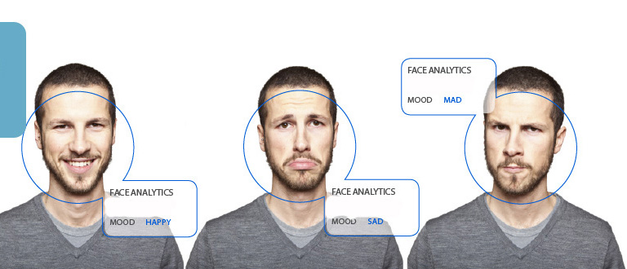
Mood detection assistant

Slide 2
MOTIVATION
As the Title says, ‘Mood Detection Assistant’ : Our project aims to assist you based on your mood.
Assistance can be given in a variety of ways, but we help you in choosing your music.
Music is an important aspect of life and our interest never settles for a particular type.
If you have a large music album , it becomes very hectic to go to that directory and open it . Therefore , it becomes essential to classify your musics according to different moods.
There comes our software which will directly give you suggestions based on your facial mood .
This comes in handy when you don’t want to search the whole directory.

Slide 3
INTRODUCTION
Digital Signal Analysis and Application is used : Individual photo is taken as signal and analyzed for mood . Music Player is the application.
It’s based on Image Processing Algorithm : PCA (Principal Component Analysis) and Eigenface Method.

Slide 4
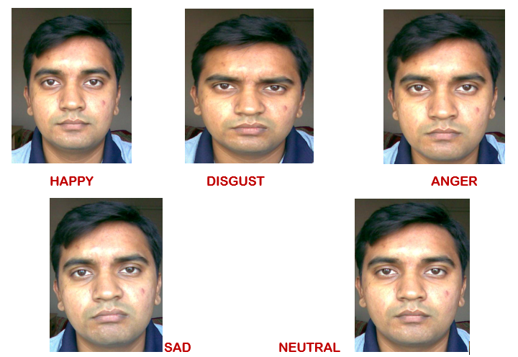
5 Basic facial expressions

Slide 5
flow chart
Load Training Images and select input image
Facial expression recognition using Eigenface method
Using Euclidean distance to recognize mood
Music plays based on the mood

Slide 6
PCA ALGORITHM - Eigenface method
The approach of expression detection involves the following initialization operations:
First gather the set having initial face images which we called as training set.
Then Calculate the eigen faces from that training set images and keep the record of M images which has the highest eigen values and other images can be discarded.
These M images are called as face space. When new eigen faces are obtained then this face space can be replaced with that values.
Then compare the images based on eigen values which matches closely( i.e., Euclidean distances)

Slide 7
result
User’s mood is iterated by the software .
Music suggestions are shown.
User can choose from the suggested musics which runs on the audio player created by us.

Slide 8
LIMITATION
Different faces, it would influence the recognition rate.
The size of face in the image would affect the result.
Real-Time Mood detection cannot be processed.

Slide 9
GROUP - 23 thank you

